Slide 1

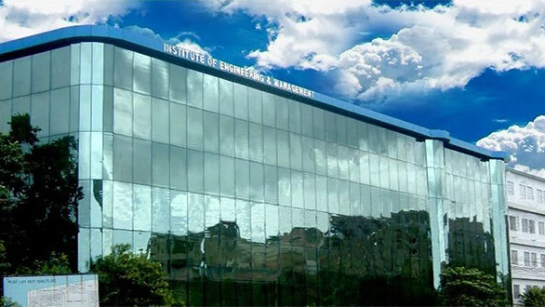


FINAL YEAR PROJECT
INSTITUTE OF ENGINEERING AND MANAGEMENT , KOLKATA
DEPARTMENT OF ELECTRONICS AND COMMUNICATION ENGINEERING

Slide 2
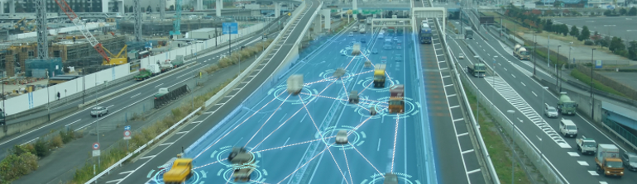
MACHINE LEARNIING MODEL TO Automate A VEHICLE

Slide 3
Presented By :
1. Akash Bharadwaj
Enrollment No. - 12018002003014
University Roll No. - 10400318193
2. Abhinav Kumar
Enrollment No. - 12018002003018
University Roll No. - 10400318203
3. Ashish Barnwal
Enrollment No. - 12018002003126
University Roll No. - 10400318173
Presented To :
Final Year Project Committee
Department Of Electronic And Communication Engineering
Institute Of Engineering And Management , Kolkata
Internal Advisor :
Prof. Debadyoti Ghosh

Slide 4
PRESENTATION FLOW
Project Objective
Features of Project
Flow Diagram
Project Parts
Project Applications
Future Enhancements
Requirement
Project Explaination
Conclusion

Slide 5
PROJECT OBJECTIVE
To create a decision making system to drive a vehicle by training a machine Learning model using the dataset of decisions taken by an individual on particular conditions .
The dataset is frequently updated by recording the decisions taken by human as well as machine on various scenarios occurred while driving a vehicle.

Slide 6
FEATURES OF PROJECT
SIMPLE
Less complex python code
Simple implemtation of ML model
Easy maintenance of dataframe using pandas and MS Excel
FLEXIIBLE
Updating the system and adding new features is easy
Easily encapsuled with various modern day AI Technologies
AUTOMATIC
Automatically update the dataset using the newly created datapoints
The machine is trained time to time using that updated datasets to become more and more accurate

Slide 7





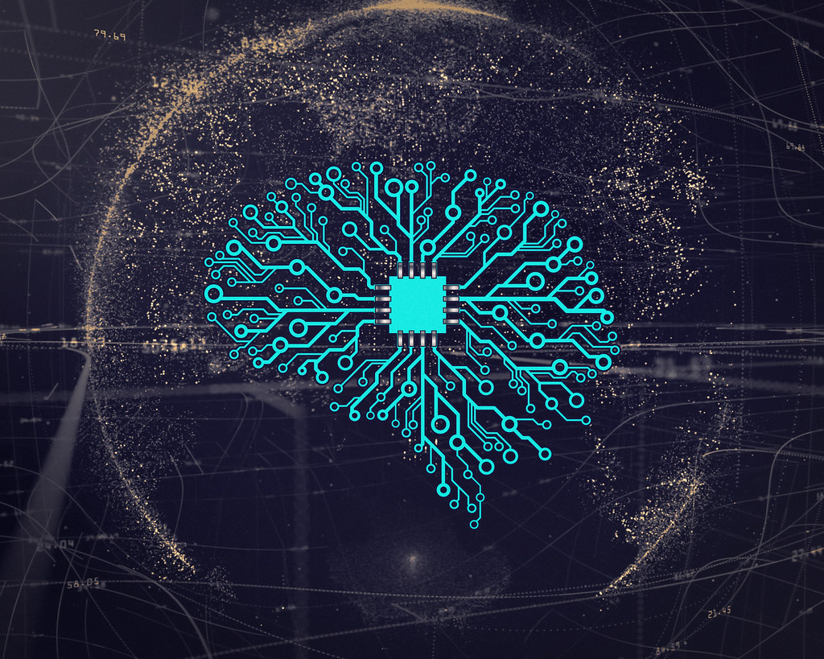
FLOW DIAGRAM
Data collected by all the sensors at a point of time
Action performed by Driver
Datapoint
Removing Duplicate Datapoints
Vehicle (Not included in this project)
Sensors for tracking speed , distance , obstacles , motion , etc. are installed in it to note their output and make a datapoint of conditions in front of the Driver
Decision taken by Human
Decision taken by Machine
Dataset
OR
Machine Learning Model Training

Slide 8
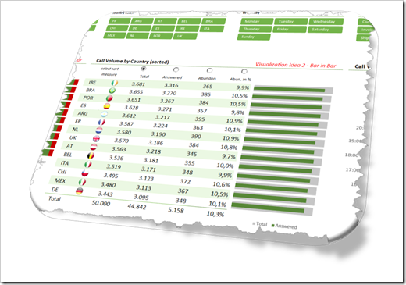
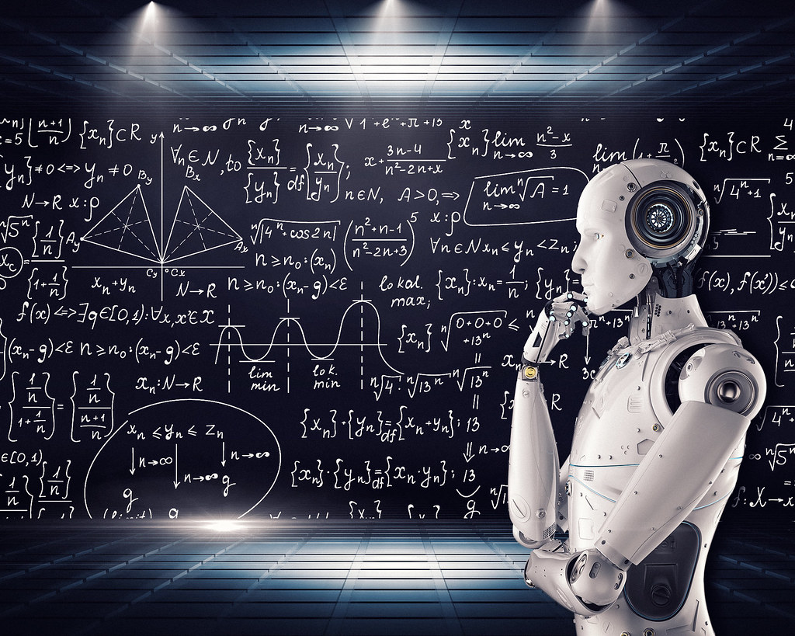
PROJECT PARTS
Maintaining core Dataset :
As there is no actual vehicle with sensors to gather those data , so for demonstration of the actual scenario we create datapoint manually and after getting the decision from human or pre-learned ML model on that particular scenario , we just merge that datapoint as one row in our core Dataset.
Training the Machine :
Create a Machine Learning Model based on supervised learning and trained it using core Dataset. Here we import many regression model and choose the model having highest accuracy

Slide 9
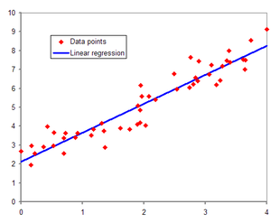
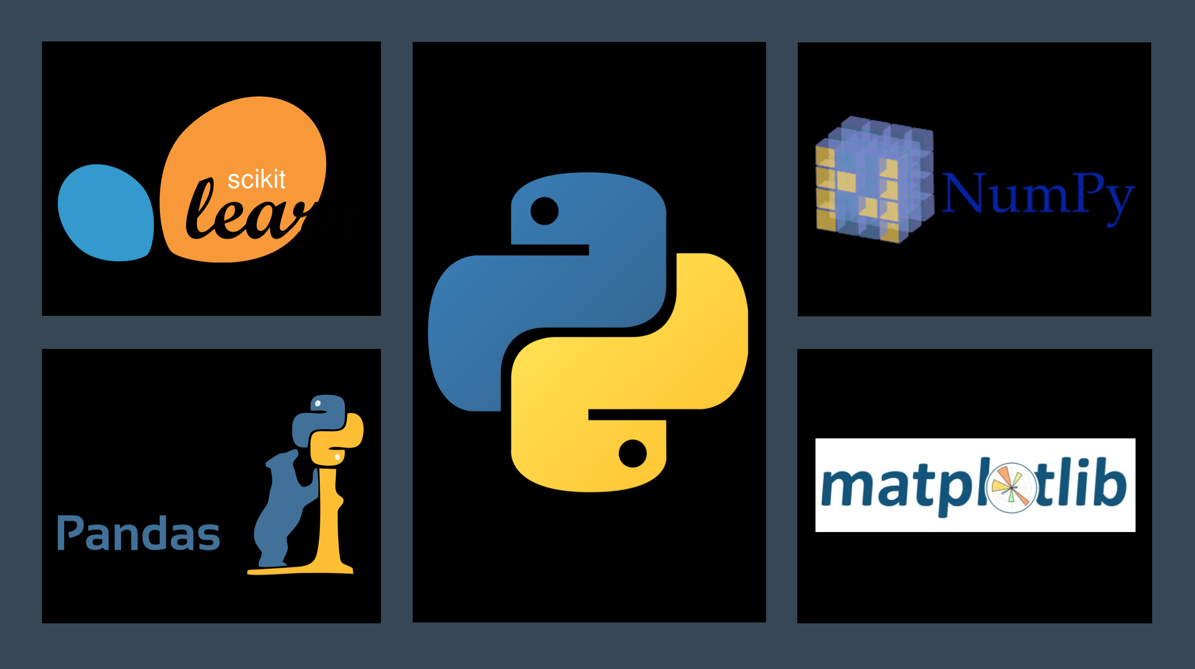


REQUIREMENT

Slide 10

WHY WE USED JUPYTER NOTEBOOK
Jupyter notebooks basically provides an interactive computational environment for developing Python based Data Science applications. They are formerly known as ipython notebooks.
The following are some of the features of Jupyter notebooks that makes it one of the best components of Python ML ecosystem:
Jupyter notebooks can illustrate the analysis process step by step by arranging the stuff like code, images, text, output etc. in a step by step manner.
It helps a data scientist to document the thought process while developing the analysis process.
One can also capture the result as the part of the notebook.
With the help of jupyter notebooks, we can share our work with a peer also.
Types of Cells in Jupyter Notebook :
Code cells − As the name suggests, we can use these cells to write code. After writing the code/content, it will send it to the kernel that is associated with the notebook.
Markdown cells − We can use these cells for notating the computation process. They can contain the stuff like text, images, Latex equations, HTML tags etc.
Raw cells − The text written in them is displayed as it is. These cells are basically used to add the text that we do not wish to be converted by the automatic conversion mechanism of jupyter notebook.
Source - https://www.tutorialspoint.com/machine_learning_with_python/machine_learning_with_python_jupyter_notebook.htm

Slide 11
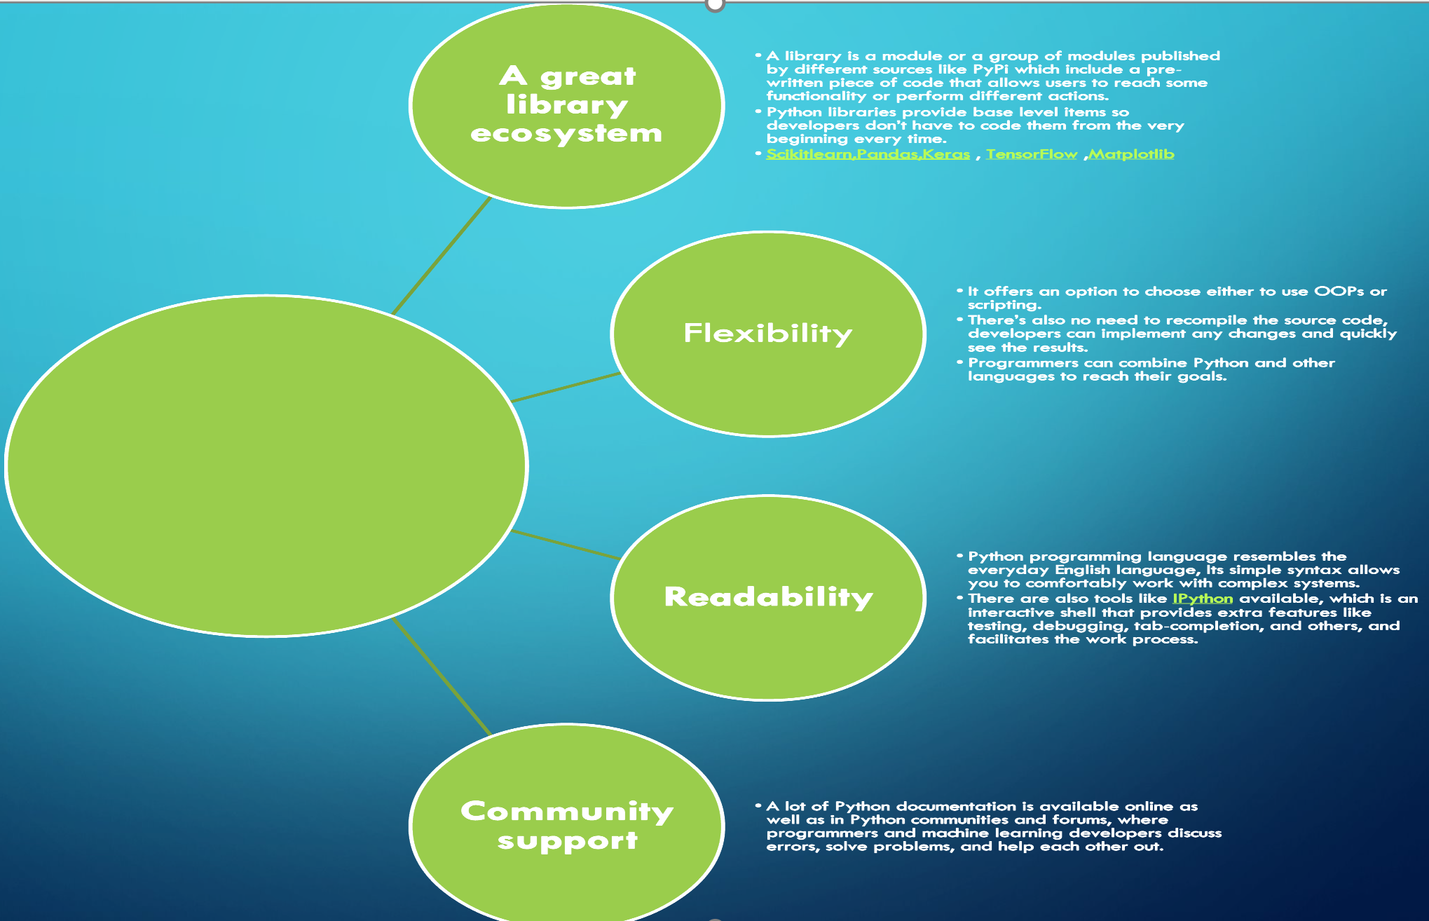

Why Python ?

Slide 12
All the dataset managing task , which we can't perform through pandas can be done using Excel.
Excel enable easy import and export of core dataset in jupyter Notebook.
Storing , Editing and sharing of dataset is easy.
Why we used MS Excel ?

Slide 13
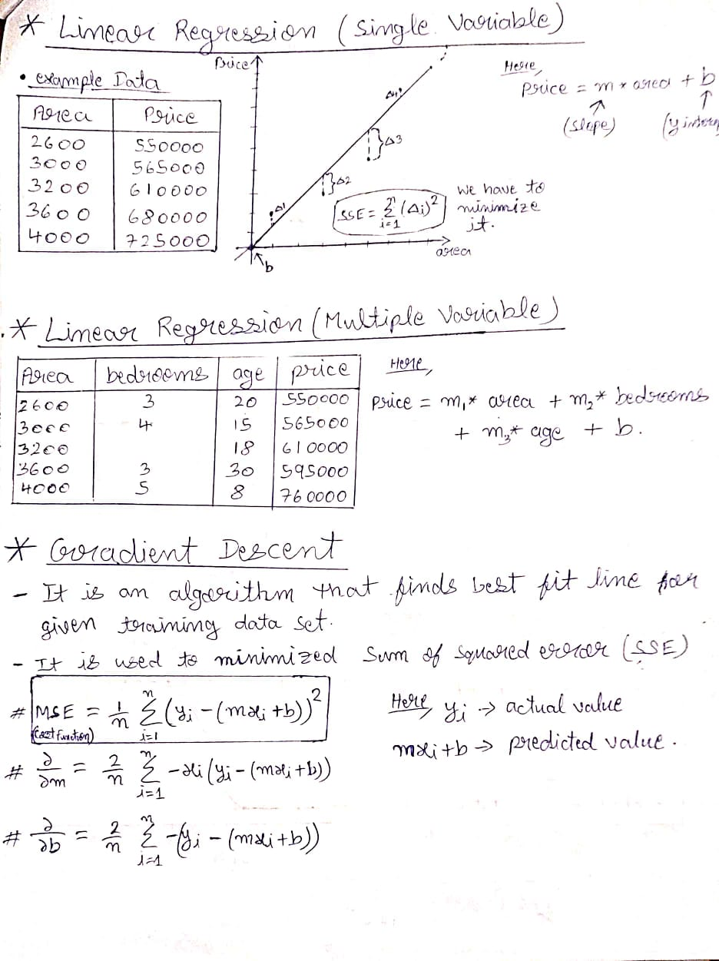
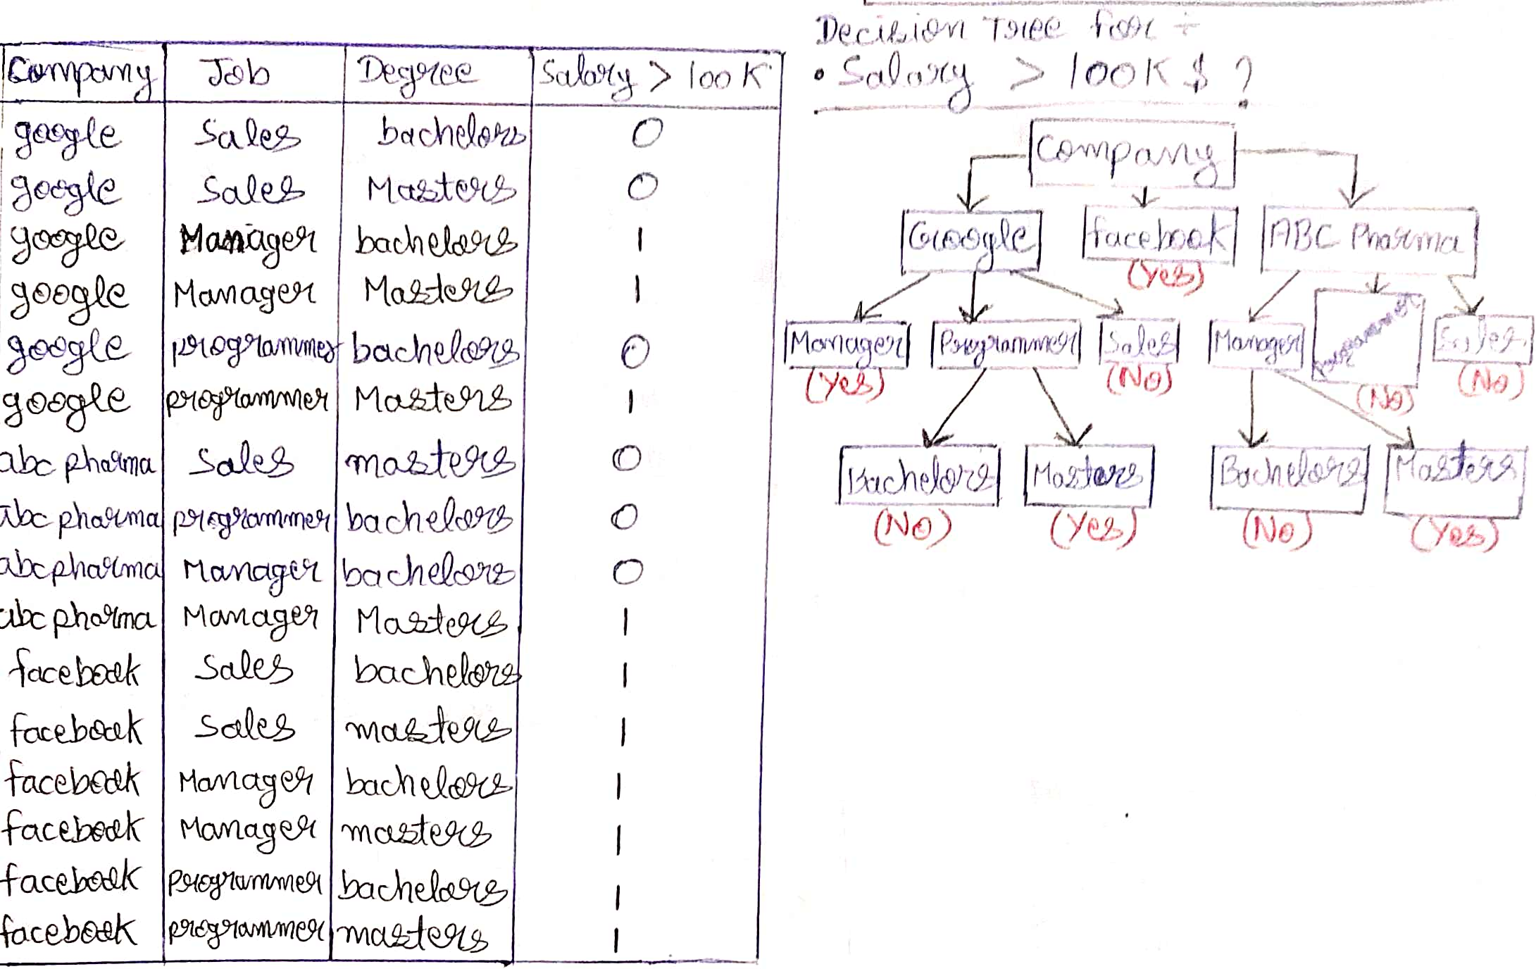
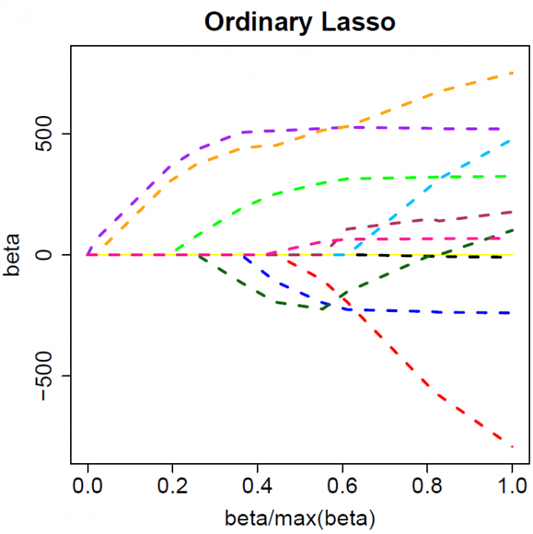
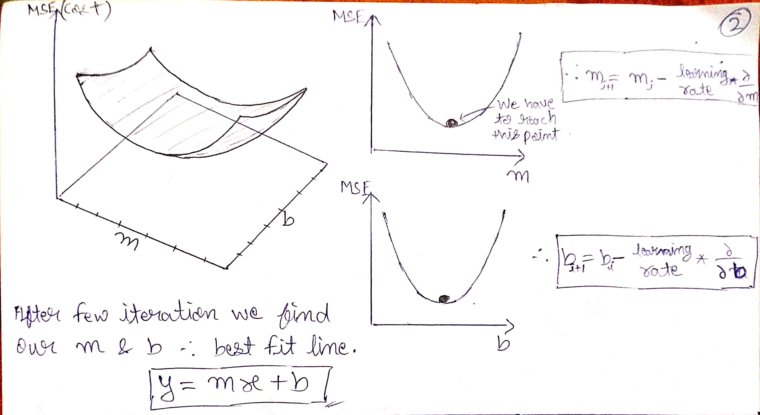
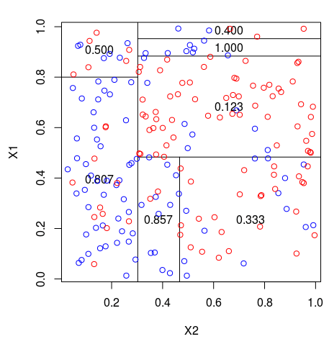
Machine learning model we used in this project
Linear Regression
DECISION TREE REGRESSION
This algorithm split datasets again and again to come up with the decision boundaries.
LASSO REGRESSION
It is a type of linear regression that uses shrinkage. Shrinkage is where data values are shrunk towards a central point, like the mean. The lasso procedure encourages simple, sparse models (i.e. models with fewer parameters)

Slide 14
How the code Works ?
Start the loop i.e driving
Fill all the necessary data asked by the code manually (as there is no actual vehicle with sensor to track those data)
Arrange those data and create a numpy array.
Choose who wants to take Decision (Human/Machine)
If 'Machine' , then put that numpy array in our ML model and extract its output. (it is only possible if we already trained our machine )
Create a datapoint by merging numpy array and Decision data and save it as one row inside our core dataset.
Run the process of Data Cleaning i.e , remove unwanted columns , remove null data , convert word data into numeric value , remove outliers , Shuffling etc
Do Train-test Splitting of dataset (80% training , 20% testing)
Import all the ML model we want to use and fill all their required parameters
If 'Human' , then enter your decision on that particular scenario.
Do 'Huperparameter tuning' using "GridSearchCV" to get best result of all Model
Select the Model having highest accuracy and make it as our final model for taking decisions.
Driving loop starts again from the beginning and the process is ON untill driver quit driving .

Slide 15
Specifications
Components of our Code
Infinite while Loop (Breaks when condition satisfied)
If-Else conditional statements
Input and print statements
Numpy ( np.array([]) , np.append() )
Pandas ( df = pd.Datafrrame() , df.append() , df = pd.read_excel() , df.to_excel() )
Columns of our Dataset
Decisions allowed for the driver to take
'Driving style'
'vehicle side'
'Front way is clear upto distance (in meters)'
'Vehicle moving alongside'
'Vehicle(alongside) speed'
'Vehicle(in front) speed(km/hrs)'
'Vehicle(in front) side is clear upto distance (in meters) (overtake situation)'
'Vehicle(approaching from behind) speed(km/hrs)'
'Vehicle(approaching from behind) distance (in meters")'
'Response Time (in sec)'
'Want to turn'
'diversion way available'
'Decision Taken by a Driver'
drive straight and maintain same speed
drive straight and increase speed
slow down
Turn right increase speed Turn Left (Overtake)
Turn left increase speed Turn right (Overtake)
brake
emergency brake
Give pass to the vehicle behind
Turn Left
Turn right
slow down take a side and stop
Scikit-learn components used
from sklearn.model_selection import train_test_split
from sklearn.model_selection import cross_val_score
from sklearn.model_selection import GridSearchCV
from sklearn.model_selection import ShuffleSplit
from sklearn.linear_model import LinearRegression
from sklearn.linear_model import Lasso
from sklearn.tree import DecisionTreeRegressor

Slide 16
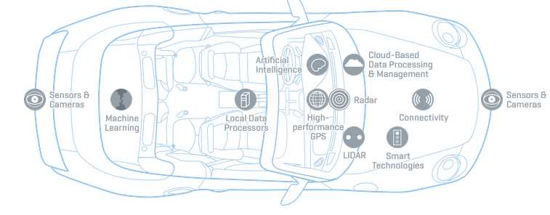
Project Applications
Our system is also maintaining data of conditions and respective decisions, so that it will further used to train our model again and again for better accuracy
Our system can be easily modified and work as a decision making system which get data about real time scenario from Local Data Processors and made decisions according to that.
Our system also collect data from all the sensors , process it and arrange it into an informative manner for better utilization

Slide 17
Limitations
There is no actual vehicle with sensors to track all those data , so we just assume the scenario and fill all data manually according to that .
We didn't consider many other parameters .
If we add any new parameter , we have to do changes manually in the structure of our core dataset as well as in the coding portion also.
There is no particular interface screen for entering data , everything is happening on jupyter notebook screen.
There is a space limitation in MS Excel , so using it is not a long term solution for data storing.

Slide 18
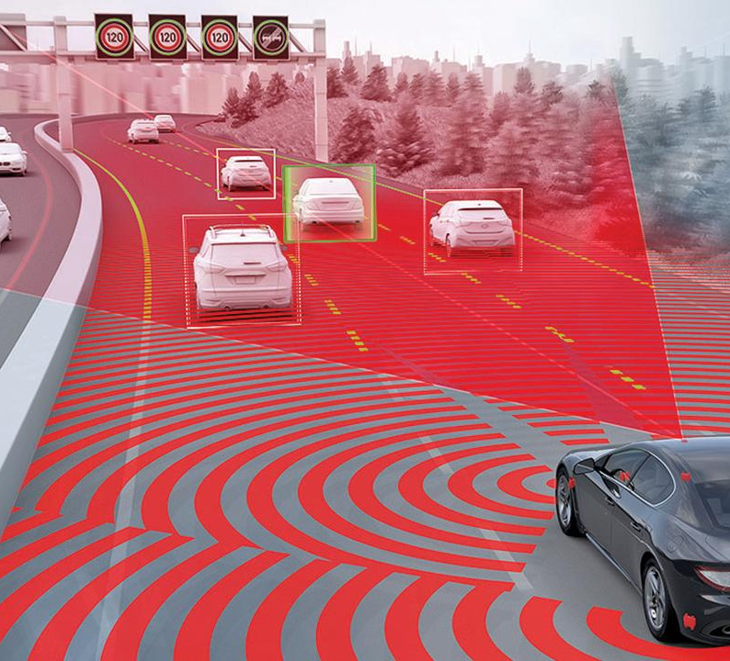
FUTURE ENHANCEMENT
Can Became more Automatic while tracking data.
We can assume more parameters and track readings according to that.
We can use this system to automate various kind of robotic vehicle which is cheap as compared to real vehicle.
We can use a dedicated interface screen rather than jupyter notebook interface.
We can use a dedicated database to store our core dataset.
We can use Augmented Reality technology for precise data tracking and accurate decision making.
We can use many other Regression model .

Slide 19
CONCLUSION
This project is a simple demonstration of an approach to automate vehicle .
This is a software based project , Hence there is no Hardware cost required .
By using this approach we can create a revolutionary AI system which can automate various kind of machine .
In this project , we try to established a good coordination between MS Excel and Jupyter Notebook , and allow smooth flow of data .
This project is one of the best example of usage of numpy array , pandas dataframe , Jupyter notebook and various Machine Learning techniques .

